Slide 1
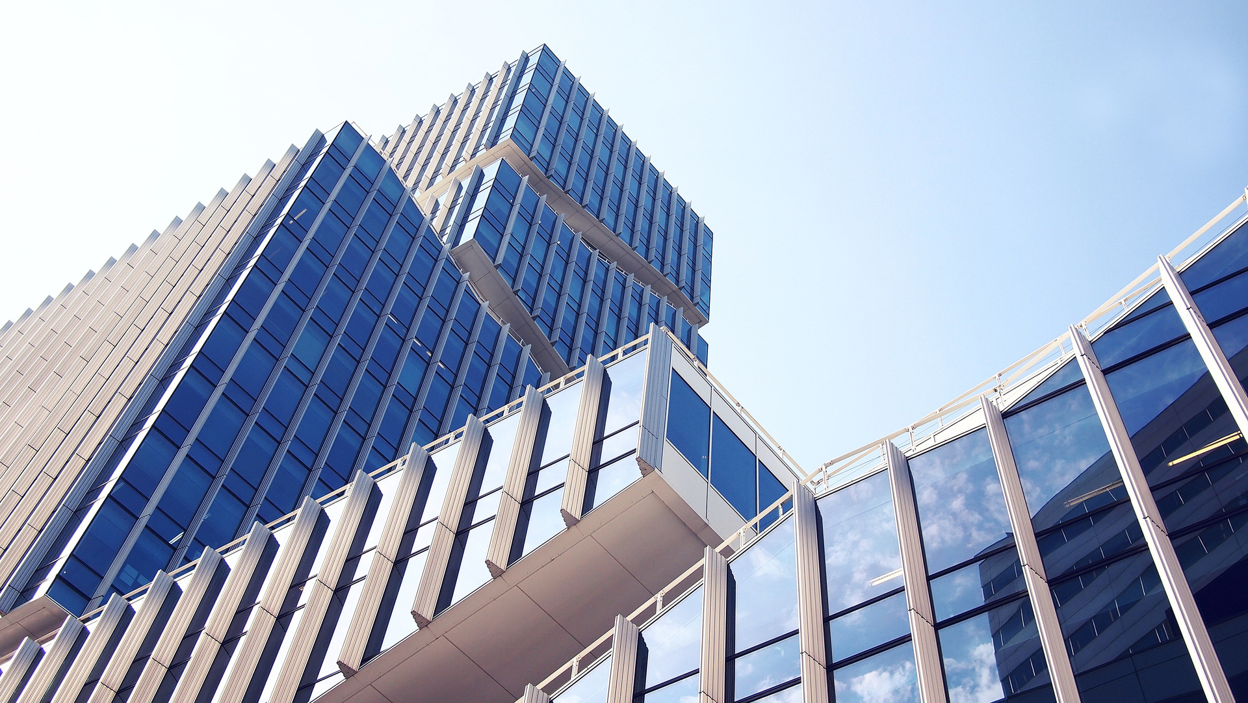



REAL ESTATE
Developer and City-wise Sales Performance Analysis
Shreya Pandey

Slide 2

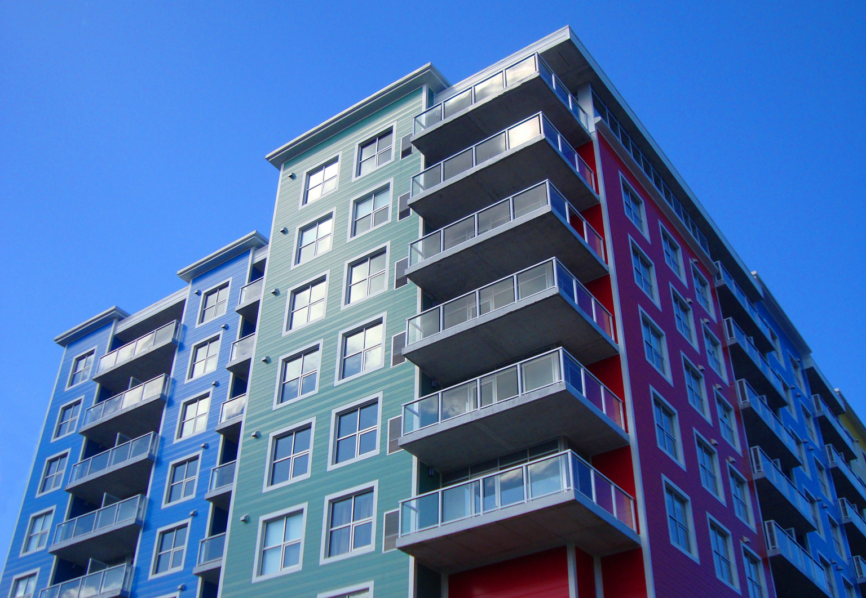

Executive summary
Latest date: 05-Oct-2025 | Cut-off: 05-Oct-2024
Total annual sales value (last 12 months, 1–3 BHK): ₹ 2,872.83 Cr
Total Jun’25 quarter sales value (all cities): ₹ 717.8 Cr
High-level concentration:
Top 5 developers contribute ~70.7% of annual sales value (Builder 6, 3, 12, 1, 4).
Top 3 cities (NCR, Goa, Hyderabad) contribute ~84.5% of Jun’25 quarterly sales.

Slide 3
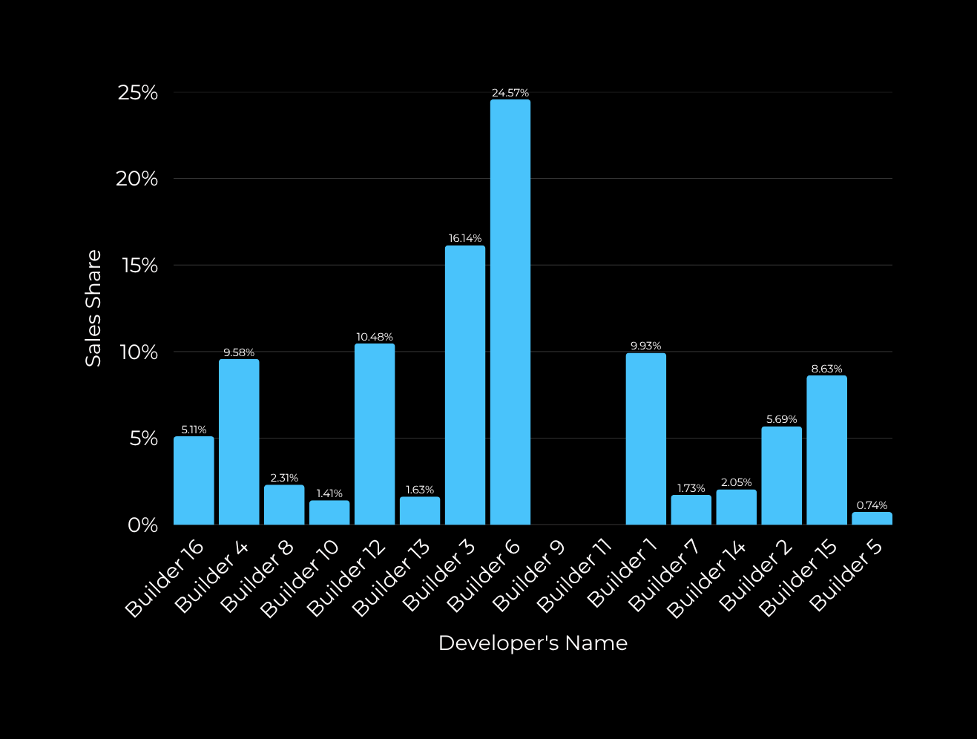

Developer share: last 12 months
Top 3 developers (6, 3, 12) = 51.19% of market by value.
Top 5 developers = 70.70% of market by value.
Two developers recorded zero sales last 12 months: Builder 9, Builder 11.

Slide 4

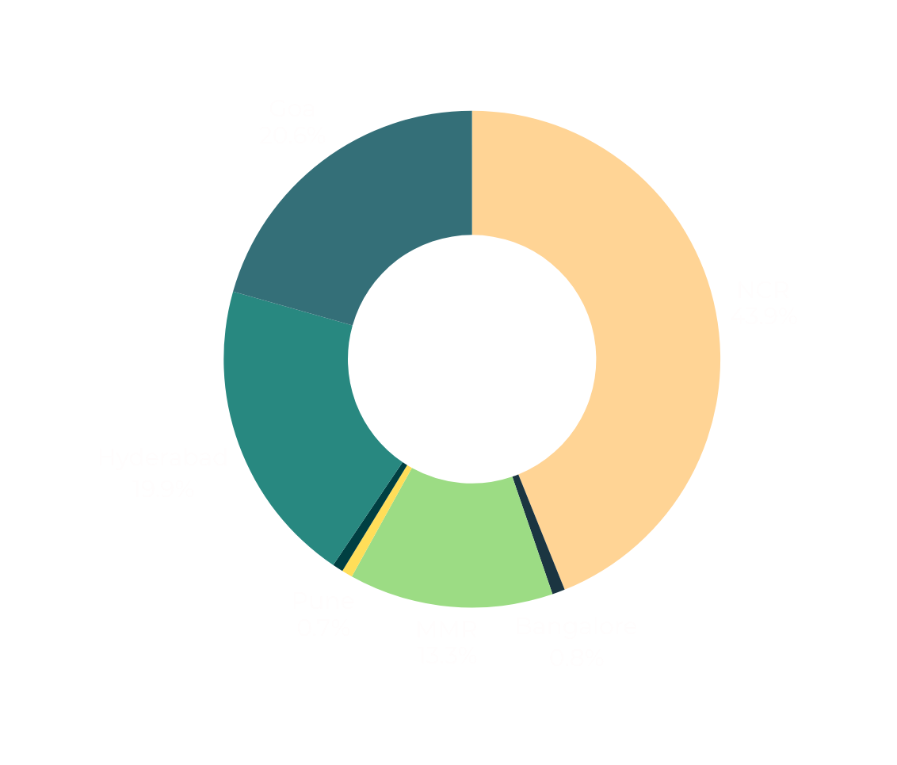
City share: Jun’25 quarter
NCR dominates — nearly 44% of quarter sales.
Three cities (NCR + Goa + Hyderabad) account for ~84.5% of quarter sales — extremely concentrated.
Secondary cities (Bangalore, Vizag, Pune) are marginal contributors (<1% each) in Jun’25.

Slide 5
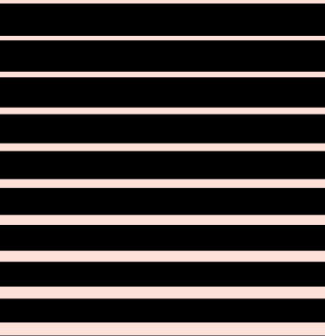

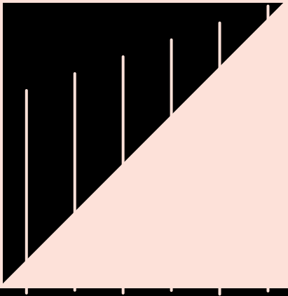
Conclusion
High concentration risk at developer level (Top-5 ≈ 70.7%) and city level (Top-3 ≈ 84.5% for Jun’25).
Some builders show no activity in last 12 months (Builder 9, 11) — verify validity (inactive projects or missing data).
City performance suggests NCR is the single largest market, with Goa and Hyderabad also contributing materially for Jun’25.

Slide 6



Thank You

